Slide 1
Hobby Web Application

Slide 2
Introduction
Approaching the project:
Read Specification and list all things to be completed.
Order the list in terms of what needs to be completed first.
Link tasks that are dependent on other tasks being completed.
With each task give a brief detail of what needs to be done.
Item Controller example:
Create: Take inputs and store into a database.
Update: Specify which item and what needs to be amended then update the changes to the existing item.
Delete: Select which item to remove and delete from database.

Slide 3
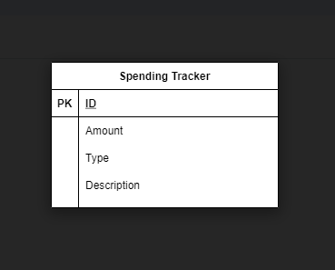
Concept
Before applying a topic to the web application listed out what were the necessary components.
At least one table in database
Interface where users can enter information (Front-end)
CRUD functionality (Buttons for each)
Next was to think of a concept that made use of these “must haves”
Design basic structure of all the components.
What the ERD would look like
What the Front-end would include
Single Page/Multiple Pages
Styling (Headers must be in bold)

Slide 4
Sprint
Must achieve
CRUD functionality
Basic Front-end user interface
Back-end
Hoping to achieve
Aesthetic design more pleasing on the eye
A more sophisticated design of the html
Some auto inputted data like date

Slide 5
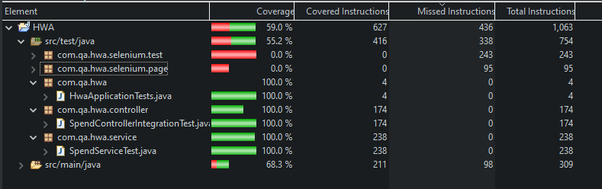
Testing Back-End

Slide 6
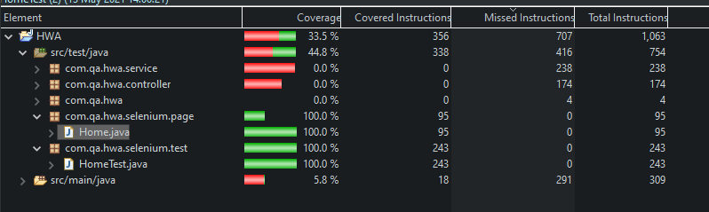
Testing Front End
Combined Coverage 92.5%

Slide 7
Technologies Used
Continued with building on the foundations laid from previous IMS project gaining further knowledge through more experience implementing the techniques As well as adding the below concepts
HTML,CSS,JAVASCRIPT
SonarQube
Selenium

Slide 8
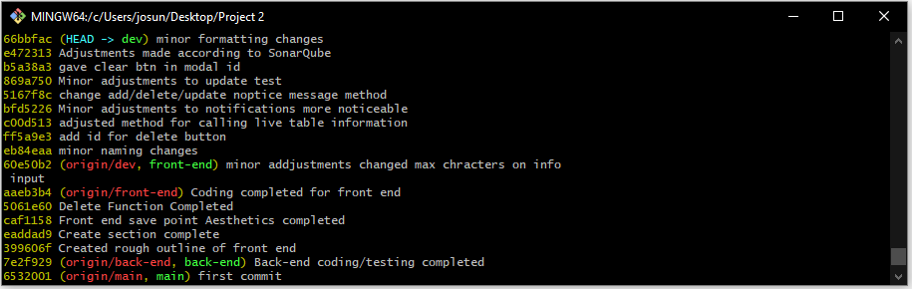
Version Control
Looked to complete the back-end first as that was probably the quickest to complete.
Paid more attention to the uses of branches and merging for better version control

Slide 9
Review
All must achieve objectives in sprint are completed.
Some minor styling has been used.
Testing has meet the 80% criteria.
The styling is all inclusive.
More could be done to make it more colourful.

Slide 10
Retrospective
More relaxed style of coding
Potentially lead to more minor bugs cropping into the programming
But problem solving in my opinion was easier due to there being more feedback when bugs did appear.
Scheduling
Happy with my planning and estimation of roughly how long each part would take
Due to good scheduling full functionality of project was reached by the beginning of this week
Had all of Thursday to review everything and make any adjustments necessary

Slide 11
Conclusion
From feedback/experience of previous project:
Still not 100% happy with version control.
Progression in testing was smoother and better than previous project
Managed to keep documentation up to date throughout the project.
Future Steps for project:
Add addition features like auto date input or attachment feature that can give pictures.

Slide 12
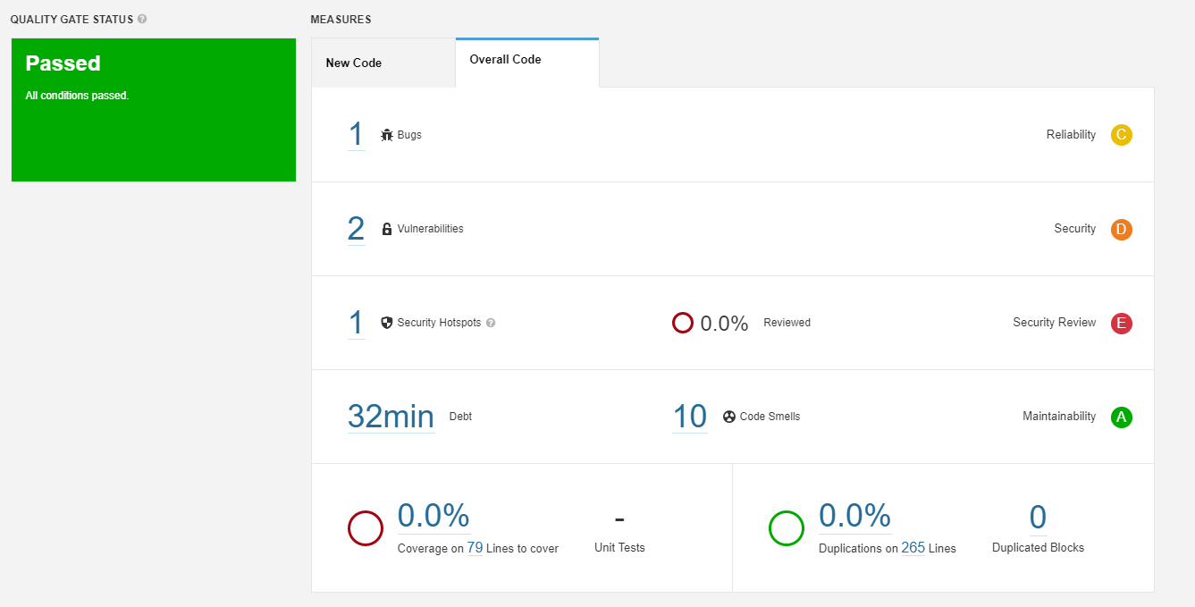
First SonarQube Run

Slide 13
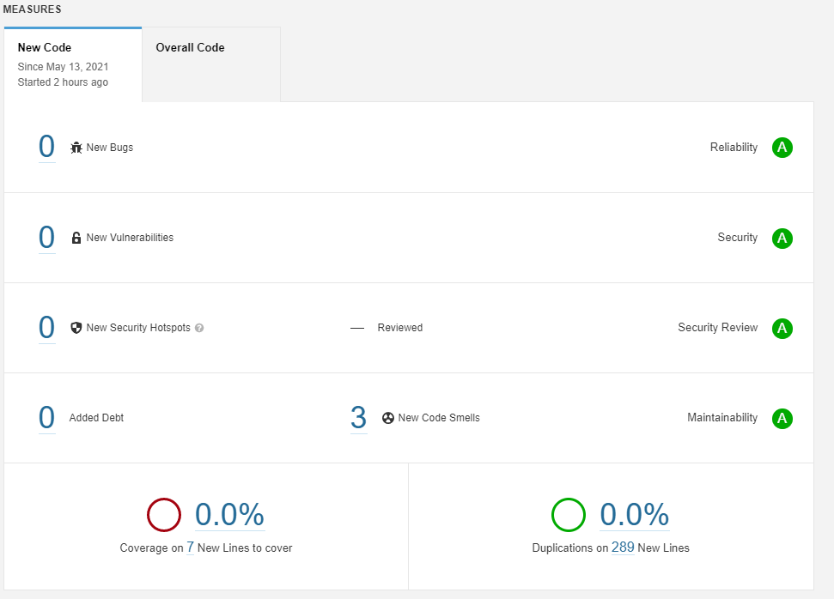
Second SonarQube Run

Slide 14
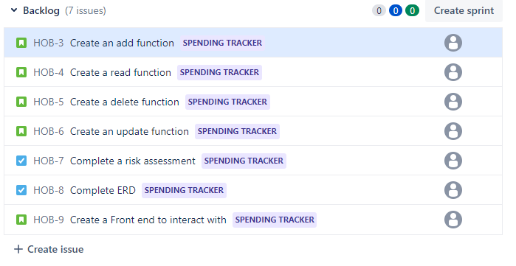

Slide 15
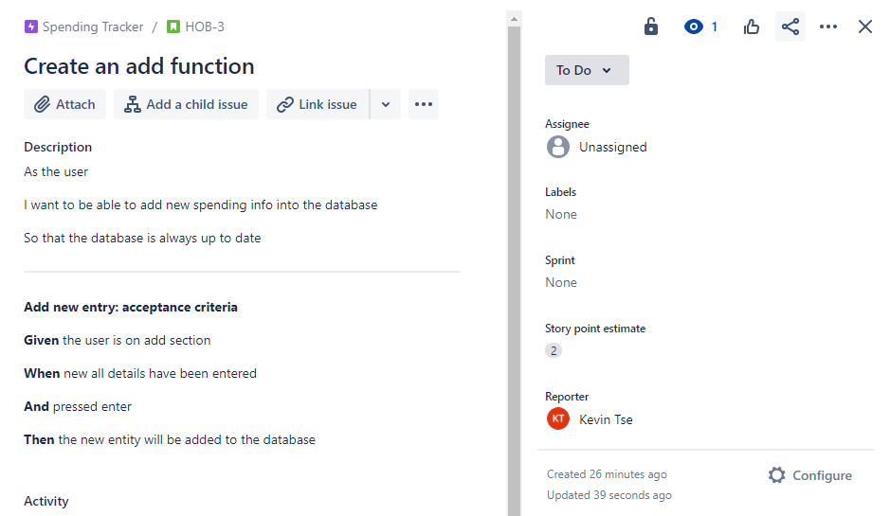

Slide 16
